Slide 1
Financial Markets and Securities Securities Market
Notes:
Introduction:

Slide 2
Agenda
IPO process, challenges of pricing
Order specification and order types
Margin trading
Short selling

Slide 3
Primary vs. Secondary Market
Primary
New issue is created and sold
Key factor: issuer receives the proceeds from the sale
Public offerings: registered with the SEC and sale is made to public
Private offerings: not registered, and sold to only a limited number of investors, with restrictions on resale
Secondary
Existing owner sells to another party
Issuing firm doesn’t receive proceeds and is not directly involved
3rd market is trading of listed securities away from the exchange. It is largely an institutional market: to facilitate trades of larger blocks of securities
4th market: Investors trading directly with other investors; Originally developed for institutional trading
Trading now on ECNs; technological developments leading to individual investors trading directly

Slide 4
How firms issue securities
Publicly Traded Companies
Raise capital from a wider range of investors through initial public offering, IPO
Seasoned equity offering: The sale of additional shares in firms that already are publicly traded
Public offerings are marketed by investment bankers or underwriters
Registration must be filed with the SEC

Slide 5
Main Steps of an IPO
Choose an investement banker (underwriter) and agree on fee and aslo conditions (spread, greenshoe, etc.)
Draft a prospectus and file it with the Securities Exchange Commission (SEC).
Marketing the deal: roadshow, presentations, book building starts
SEC approves the registration
Sell the shares to the investment banker, who selling to investors.
Listing. Trading starts

Slide 6
Prospectus
Objectives:
It informs investors about the company.
It serves as a written evidence about the terms and conditions of issue of shares or debentures of a company.
It induces the investors to invest in the shares and debentures of the company.
It describes the nature, extent and future prospectus of the company.
It maintains all authentic records on the issue and make the directors liable for the misstatement in the prospectus.
Facebook Prospectus

Slide 7
Pricing of an IPO
Timing is crutial
Book building process
Pricing Method: Fixed price or auction
Auction types: discriminatory and uniform-price
Pricing is sensitive: too high difficult to sell out or bad performance after listing
too low the company receives less capital inflow, dilution of profit and control for relatively cheap price
Investors Underwriters Company
Notes:
TPSA: Trade Union organised strike after IPO

Slide 8
Cost of IPO
The spread between the issue price and the price, where the underwriter allow to buy stock from the co.
Depends of the issue size: set in %, but this is confidential
This cost covers:
Cost of the registration
Prospectus
Travel and roadshow
Legal cost, accountants, other external advisers (esp. in energy, technology,

Slide 9

Facebook IPO
Facebook IPO on May 18, 2012.
The IPO was one of the biggest in technology, and the biggest in Internet history, with a market capitalization of over $104 billion.
The company targeted a valuation from $28 to $35/sh. ($77 billion to $96 billion)
Set a price range of the issue as $34 to $38 per sh. in mid May.
Underwriters settled on a price of $38 per share, at the top of its target range.
Initial trading saw the stock shoot up to as much as $45 on the listing day.
The stock closed its second full week of trading on June 1 at $27.72.

Slide 10
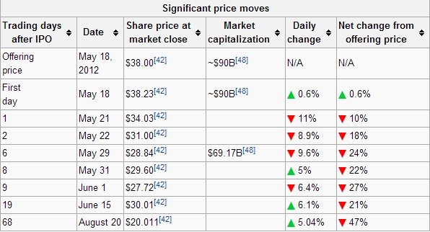
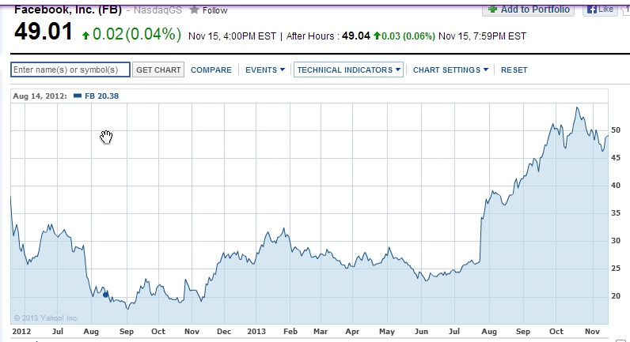
Facebook IPO

Slide 11

Twitter IPO
Too big hype on the issue and special from the public attention
Price set lower range: $17-20,
90% not recommended the issue,
prefer to buy later.... What happened??
Twitter IPO price fixed at $26,
First trading day: $44,90 (+73%) now trading at 51,45USD
What is the conclusion??

Slide 12
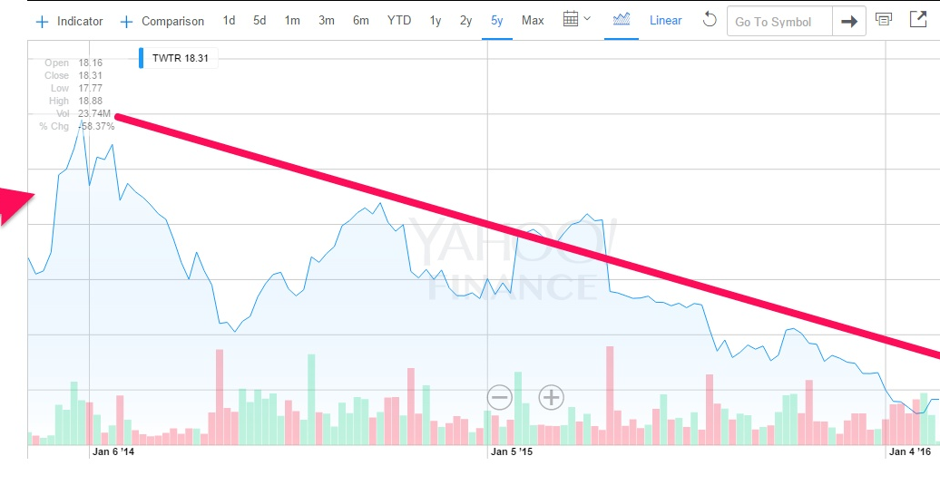
Twitter Price

Slide 13
Functions of Financial Markets
Overall purpose: provide the structure and processes that allow an efficient allocation of capital, through…
Bring together buyers and sellers at low cost
Provide adequate liquidity by minimizing time and cost to trade and promoting price continuity.
Set & update prices of financial assets
Reduces information costs associated with investing
Notes:
Direct search: put an ad in the paper to find a buyer or seller
Brokered: real estate

Slide 14
Types of Markets
Direct Search Markets
Buyers and sellers locate one another on their own
Brokered Markets
3rd party assistance in location buyer or seller
Dealer Markets
3rd party acts as intermediate buyer/seller
Auction Markets
Brokers & dealers trade in one location, trading is more or less continuous

Slide 15
Bid and Asked Prices
Bid Price
Ask Price
Bids are offers to buy.
In dealer markets, the bid price is the price at which the dealer is willing to buy.
Investors “sell to the bid.”
Bid-asked spread is the profit for making a market in a security.
Asked prices represent offers to sell.
In dealer markets, the asked price is the price at which the dealer is willing to sell.
Investors must pay the asked price to buy the security.
Notes:
The spreads between dealers’ buy (or “bid”) prices and sell (or “ask”) prices are a source of profit.

Slide 16
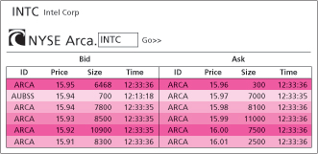
Types of Orders
Instructions to the brokers on how to complete the order
Market order: execute immediately at the best price
Limit order: Order to buy or sell at a specified price or better
Notes:
On NASDAQ, limit may have stayed with broker in old days, now goes to SuperMontage I believe

Slide 17
Types of Orders Continued
Stop loss sell order: Becomes a market sell order when the trigger price is encountered.
Stop loss buy order: Becomes a market buy order when the trigger price is encountered.
Discretionary order: gives the broker the power to buy and sell for your account at the broker's discretion.
Time dimension on orders (other than market orders):
IOC: immediate or cancel
Day: by default
GTC: good until canceled (usually 60 days max)
Notes:
What is the risk of the day order and GTC?

Slide 18
Trading Costs
Commission: fee paid to broker for making the transaction
Spread: cost of trading with dealer
Bid: price dealer will buy from you
Ask: price dealer will sell to you
Spread: ask – bid
Tipically the forex market pricing
Combination: on some trades both are paid

Slide 19
U.S. Markets
NASDAQ
Lists about 3,000 firms
Originally, NASDAQ was primarily a dealer market with a price quotation system
Today, NASDAQ’s Market Center offers a sophisticated electronic trading platform with automatic trade execution
Large orders may still be negotiated through brokers and dealers
The New York Stock Exchange
The largest U.S. stock exchange as measured by the value of the stocks listed on the exchange
Automatic electronic trading runs side-by-side with traditional broker/specialist system
SuperDot : Electronic order-routing system
DirectPlus: Fully automated execution for small orders
Specialists: Handle large orders and maintain orderly trading

Slide 20
U.S. Markets
ECNs
Private computer networks that directly link buyers with sellers for automated order execution over multiple exchanges
Compete in terms of the speed they can offer
Latency: The time it takes to accept, process, and deliver a trading order
Major ECNs include Direct Edge, BATS, and NYSE Arca

Slide 21
New Trading Strategies
Algorithmic Trading
The use of computer programs to make trading decisions
High-Frequency Trading
Special class of algorithmic with very short order execution time
Dark Pools
Trading venues that preserve anonymity, mainly relevant in block trading

Slide 22
Characteristics of good market
Competitive: Low cost transfer of funds (among market makers and brokers).
High trading volume: Adequate trading activity to ensure purchases and sales occur in timely fashion without affecting price.
Operational or internal efficiency
c) Efficient: Prices speedily reflect public information
Notes:
a) Perhaps Nasdaq style system has an edge here
b) NYSE and Nasdaq are both deep and active
c) Perhaps slight edge to NYSE? w/ more analyst coverage and institutional interest (excluding techs)
c) Informational: Are price changes predictable so that you can earn more than you should for the risk level you are taking
Allocational: Are prices accurately reflecting the prospects of firm/issuer cash flows? Behavioralism attacks the allocational efficiency more than informational efficiency so the distinction is important.

Slide 23
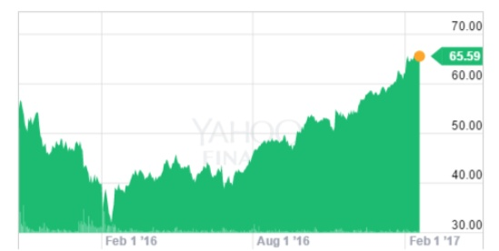
The Long & Short of “Round Trips”
A “Round Trip”
Long position
Buy first and sell later
Bullish .
.
Short position
Sell first and then buy later
Bearish
Sell
Sell
Long
Short
Buy
Buy
Notes:
Not in notes

Slide 24
Buying on Margin
Securities purchased with money borrowed in part from a broker. The margin is the net worth of the investor’s account.
From whom do you borrow? What is a hypothecation agreement? Do you pay interest on the loan?
Equity = Position Value - Borrowing + Additional Cash
Initial Margin: currently: Currently 50%
Maintenance margin requirement (MMR): minimum amount equity can be before additional funds must be put into the account
Exchanges mandate minimum 25%.
Notes:
Brokerage rules are generally more restrictive than exchange minimum requirements and typically include fixed dollar minimums.

Slide 25
Margin Trading
Margin call: notification from broker you must put up additional funds or have your position liquidated.
At what price does the investor receive a margin call? While the position is open the investor's equity = Market Value - Amount borrowed
Thus a declining stock price reduces the investor's equity.
If the Equity / Market Value ≤ MMR a margin call occurs.
(Market Value - Borrowed) / Market Value ≤ MMR ; solve for Market Value
A margin call will occur when:
Market Value = Borrowed / (1 – MMR)

Slide 26
Margin Trading
Margin Trading: Initial Conditions
1000 Shares Purchased of
X Corp At the Stock price of $70 50% Initial Margin 40% Maintenance Margin
Initial Position | Total Market Value
Stock | $70,000 | Borrowed | $35,000
 |  | Equity | $35,000
Stock price falls to $60 per share
New Position | Total Market Value
Stock | $60,000 | Borrowed | $35,000
 |  | Equity | $25,000
Margin% = $25,000 / $60,000 = 41.67%
Margin Trading: Margin Call How far can the stock price fall before a margin call? (MMR = 40%)
Market Value = Borrowed / (1 – MMR)
Market Value = $35,000 / (1 – 0.40) = $ 58,333

Slide 27
Margin Trading
With 1000 shares, the stock price at which we receive a margin call is $58,333 / 1000 = $58.33
New Position
Stock | $58,333 | Borrowed | $35,000
 |  | Equity | $23,333
%Margin = $23,333 / $58,333 = 40%
How much cash must you put up?
To restore the IMR you will need equity =
have equity = so owe
½ x $58,333 = $29,167
$23,333
$ 5,834

Slide 28
Margin Trading
Why do people purchase on margin?
Suppose you buy at $70 per share (borrow at a 7% APR interest cost if use margin, use full amt. margin)
APRs (365 day year)
Do institutions generally purchase on margin?
Buy at $70 | Sell at $72 in 90 days | Sell at $68 in 90 days
No Margin | 11.59% | -11.59%
Margin | 16.17% | -30.17%
Leverage Factor | 1.4x | 2.6x
Notes:
7% rate will be at a markup over the "Call Money Rate," which is currently at 7%, Sep 07, see Money Rates, WSJ Online

Slide 29
Short Sales
Purpose
To profit from a decline in the price of a stock or security
Mechanics
Borrow stock from a broker/dealer, must post margin
Broker sells stock and deposits proceeds and margin in a margin account (you are not allowed to withdraw the sale proceeds until you ‘cover’)
Covering or closing out the position: Buy the stock and broker returns the stock title to the party from which it was borrowed .
Notes:
May want to talk about 'naked short selling,‘ although this will show up in a later slide. In a naked short a trader sells shares that have not yet been borrowed. This is problematic and probably should be prohibited.

Slide 30
Short Sales
Required initial margin: usually 50% but more for low priced stocks
Maintenance Margin
Liable for any cash flows: Dividend on stock
Notes:
Zero tick, uptick rule was eliminated by the SEC in July 2007 although I think it may be restored. This rule originated in the 1930s after the crash.

Slide 31
Short Sales
Example: You sell short 100 shares of stock priced at $60 per share.
The proceeds of $6000 must be pledged to broker.
You must also pledge 50% margin.
You put up $3000. Now you have $9000 invested in margin account.
Short Sale Equity = Total Margin Account - Market Value
Maintenance margin for short sale of a stock with price > $16.75 is 30% of market value or 30% x $6,000 = $1,800 So you have 1200 in excess margin. (This may be withdrawn at your pleasure but assume that it is not.)
At what stock price do you get a margin call?

Slide 32
Short Sale: Initial Conditions
Dot Bomb 1000 Shares
50% Initial Margin
30% Maintenance Margin
$100 Initial Price
Sale Proceeds $100,000
Margin & Equity $50,000
Stock Owed 1000 shares

Slide 33
Short Sale: Dot Bomb falls to $70
Assets
Liabilities
$100,000 (sale proceeds)
$50,000 (initial margin)
$70,000 (buy shares)
Equity
$80,000
Profit = Ending equity – Beginning equity
= $80,000 - $50,000 = $30,000
= Decline in share price x Number of shares sold short

Slide 34
Short Sale: Margin Call
How much can the stock price rise before a margin call?
($150,000* - 1000P)/(1000P) = 30%
P = $115.38
* Initial margin plus sale proceeds
Notes:
34

Slide 35
Short Sales
When: Equity ≤ (0.30 * Market Value)
Equity =
When: Market Value = Total Margin Account / (1 + MMR)
Market Value = $9,000 / (1 + 0.30) = $6,923
Price at which get a margin call: $6,923 / 100 shares = $69.23
Total Margin Account – Market Value
Notes:
We sold short 100 shares of stock so margin call occurs at a stock price of $6,923 / 100 = $69.23.

Slide 36
Short Sales
If this occurs:
Equity =
Equity as % market value =
You get a margin call & You may have to restore the 50% initial margin.
If so you must deposit an additional
($6,923 / 2) - $2,077 = $1,384.5
$9,000 - $6,923 = $2,077
$2,077 / $6,923 = 30%

Slide 37
Thank you for the attention!
Any Questions?

